Slide 1
MIS 446
MIDTERM PRESENTATION
WORLD HAPPINESS REPORT
NICOLE DUFF, YEN VO

Slide 2
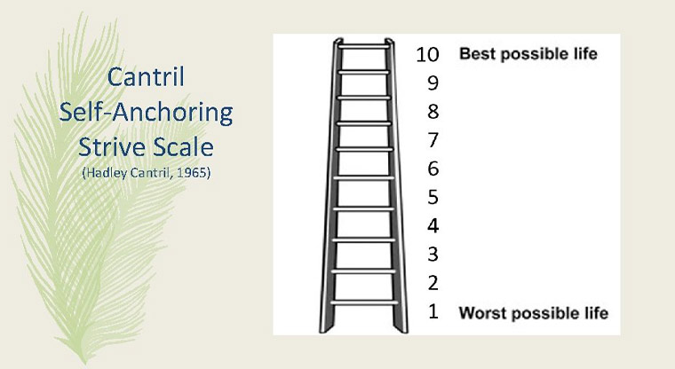
WORLD HAPPINESS REPORT
First published in 2012 and most recently in 2021
Ranks 155 countries based on their level of happiness
Uses data from the Gallup World Poll
The Cantril Ladder question asks participants to rank their lives on a scale from 1 to 10
This score is used for the main life evaluation data
Other factors used to determine the happiness level of a country include GDP per Capita, Family, Life Expectancy, Freedom, Generosity, Trust, and Government Corruption

Slide 3
INFORMATION USER
Governments use happiness indicators to guide policy decisions
Experts in many fields (psychology, economics, statistics) use these measurements to assess how countries are progressing

Slide 4
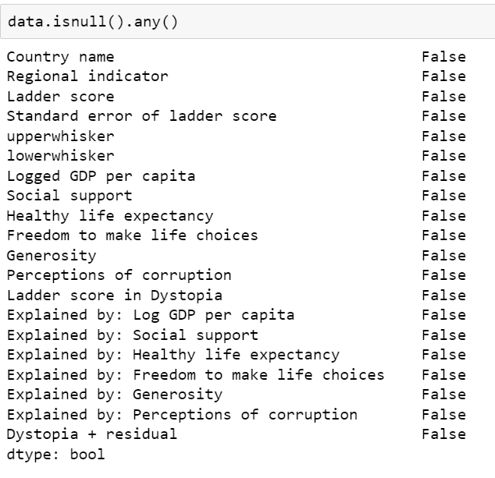
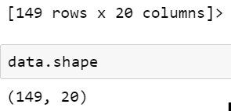
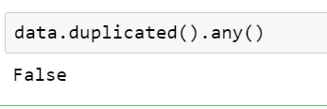
DATA PROCESSING
We used Jupyter notebook to analyze and clean the data set.
No duplicated data
No null value

Slide 5
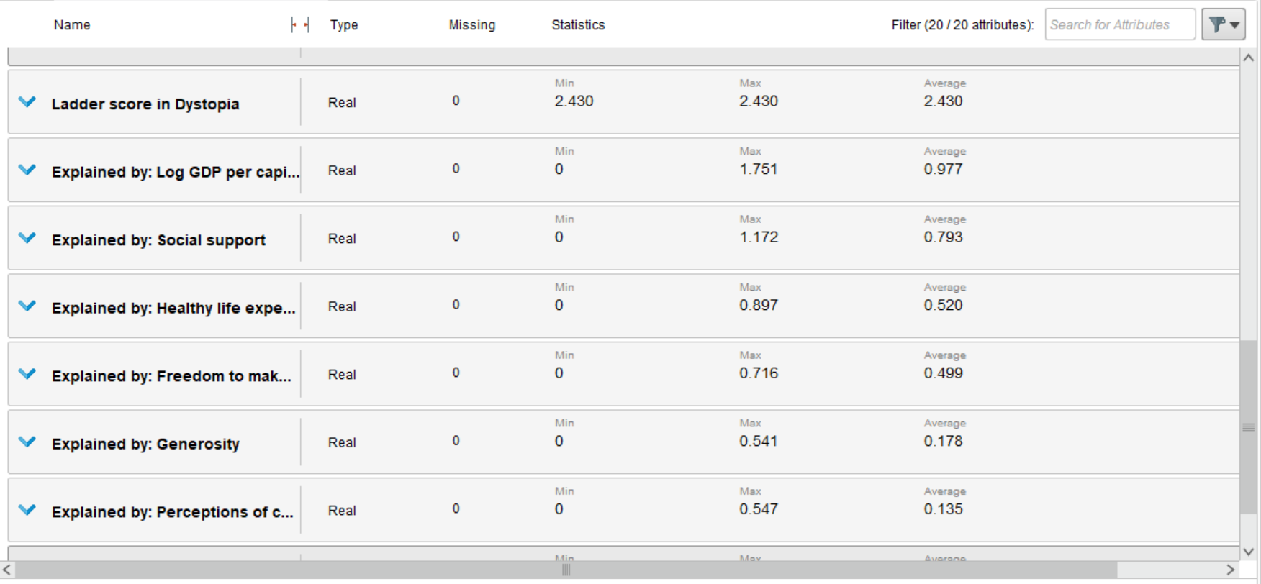
Rapid Miner: No missing value

Slide 6
Research Questions
01.
02.
03.
What make each country happy?
Which areas are the happiest?
How has the happy index changed over time?
04.
Which factors have the greatest impact on happiness?
05.
How freedom of life choices have affected to the happiness?

Slide 7
OUR PROJECT’S GOALS:
We aim to explain why some countries rank higher than others and what can be done to improve a happiness rating by using six factors:
Economic production ( GDP)
Social support
Life expectancy
Freedom
Absence of corruption
Generosity

Slide 8
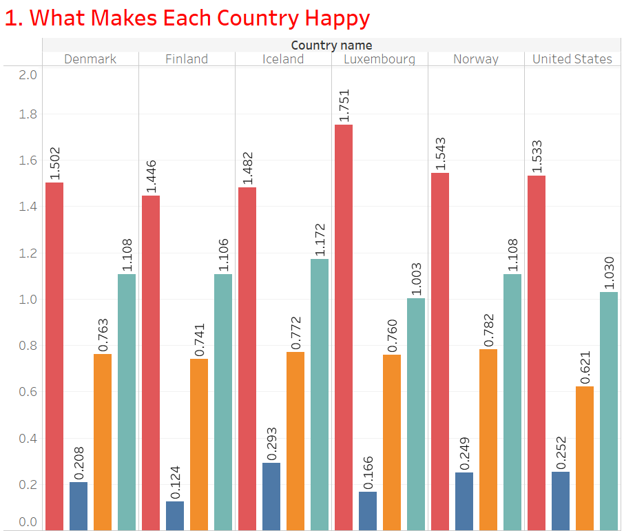
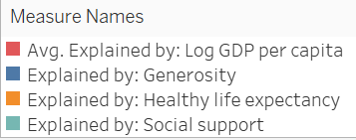
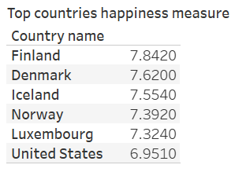
High GDP per capita
High Generosity
High Healthy life expectancy
High social support

Slide 9
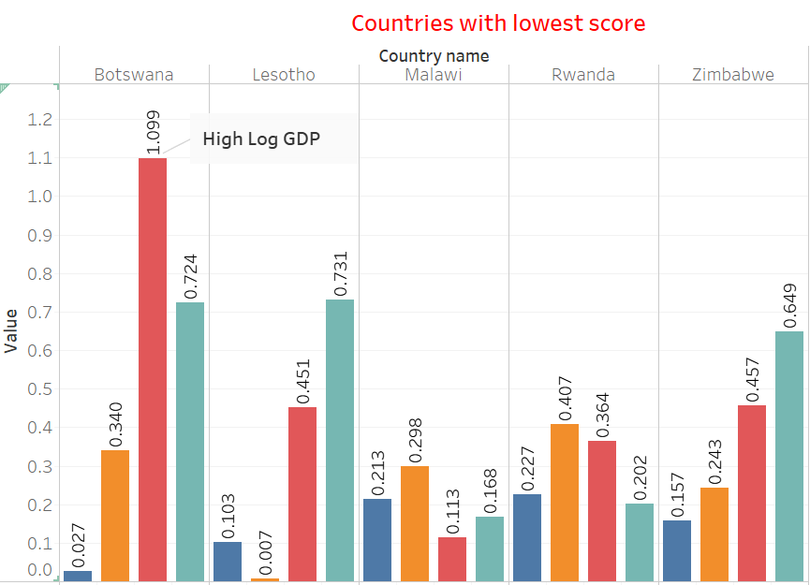
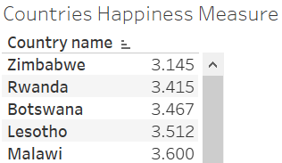
Lower GDP
Lower Life Expectancy
Lower Social Support
High Generosity

Slide 10
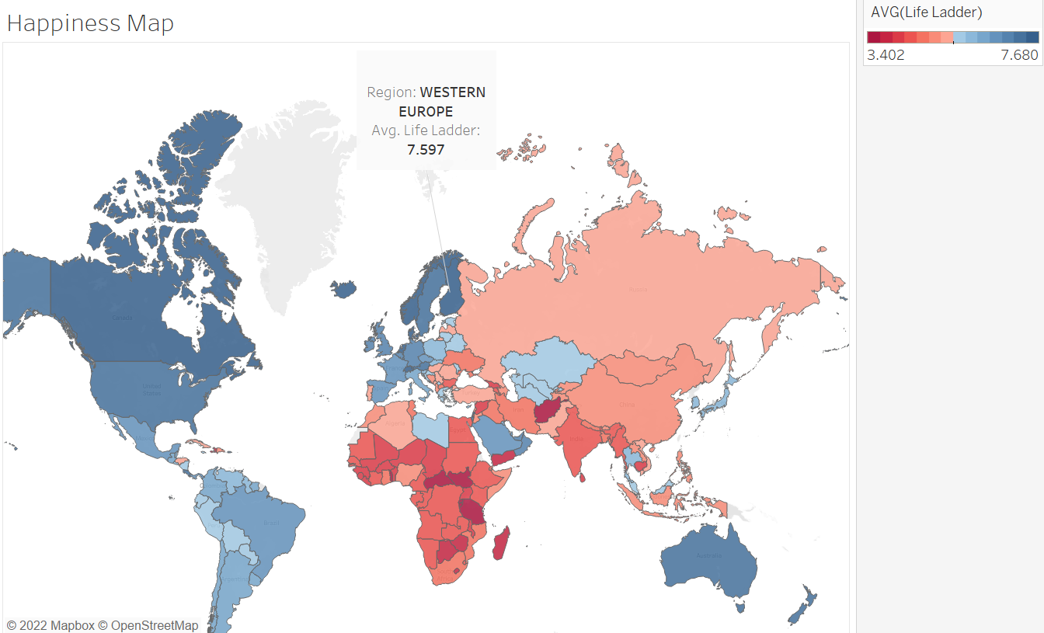
Which areas of the world are the happiest?

Slide 11
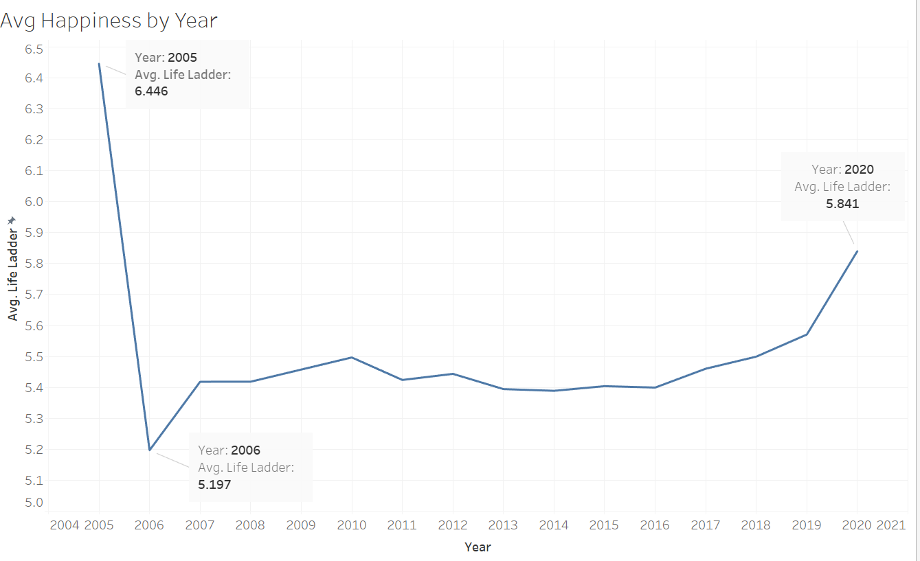
How has the happiness index changed over time?
The highest happiness index was recorded in 2005, but only 27 countries were surveyed that year.

Slide 12
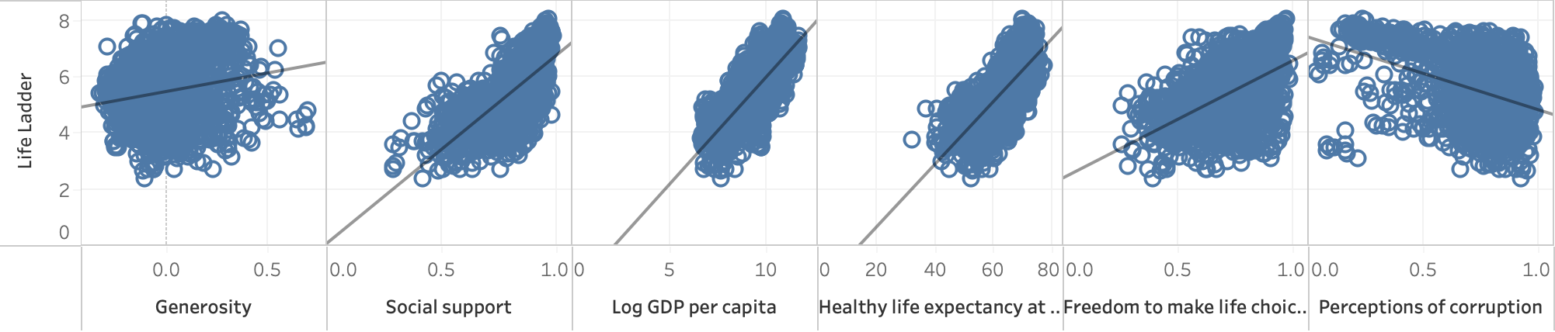
Which factors have greatest impact on happiness?
Log GDP per capita has the highest R² value
Generosity has the weakest influence on happiness
Perception of corruption has a negative impact on happiness
Notes:
Log GDP per capita has the highest R² value
Generosity has the weakest influence on happiness
Perception of corruption has a negative impact on happiness

Slide 13
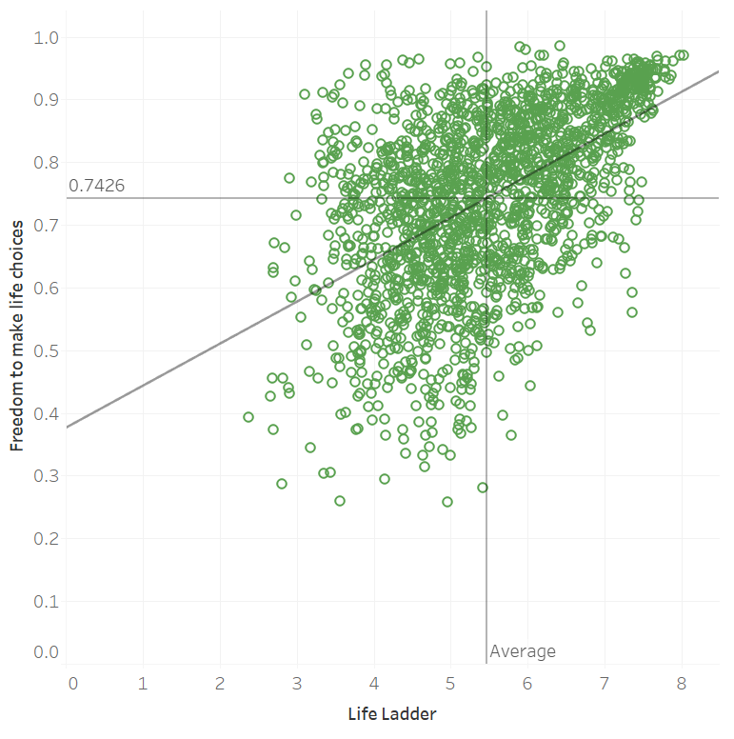

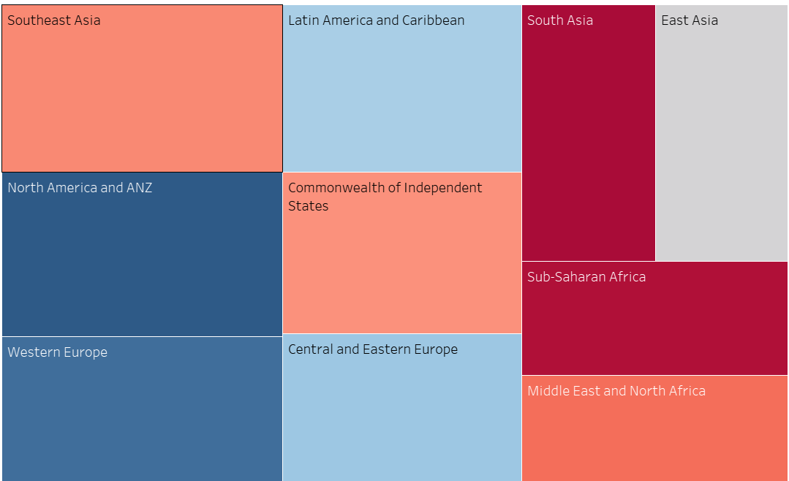
Freedom of life choices Visualization

Slide 14
How freedom of life choice has affected the happiness?
Countries with high happiness index tend to have higher freedom of life choice
North American ( Including USA) is the top region with highest freedom of choice, following Western Europe.
Africa and South Asia has lowest freedom of life choice index.

Slide 15
CONCLUSIONS:
Happier countries tend to be those with higher GDP, longer life expectancy
Countries with lower scores have lower GDP, lower life expectancy, and less social support
Europe and North America have the happiest countries, while Africa and Asia have the unhappiest countries
The happiness index was relatively constant from 2007 to 2016, but it seems to be trending upward.
Generosity does not have a significant impact on happiness levels

Slide 16
THANK
YOU

